Slide 1


A project on
Medical Devices Inventory management
In collaboration with
Under the guidance of
Prof. Kal Bugrara

Slide 2

Problem Statement
PHS is interested in an effective way of utilizing their expensive medical equipment. They want to share expensive equipment across its network of service providers (e.g., hospitals). Thus, eliminate the need to stock expensive equipment that won’t be used often.
Good management of device utilization has impact on the clinical operations such as surgeries which have heavy dependence on the availability of medical devices. Good management of device inventory means efficient utilization of the operating rooms as well as efficient use of clinician time and staff time.
???How should I schedule my devices
to use them effectively???
PHS

Slide 3


Proposed Solution
Effective utilization can be achieved with the help of centrally managing the scheduling of the devices.
A designated person will always keep a track of devices. All the requests for the devices will be directed
to him.
He will be able to schedule the device for a particular date and particular slot of that day depending on the requests of the organizations.
If a particular device is not present in the organization he should be able to order the
same by following the proper hierarchy.
Scheduling is the key!

Slide 4
Scope of Project
The system in the project is scalable to multiple networks. But internetwork communication is not yet tested.
Inventory management of equipment's is supported.
Scheduling of room ,surgery and device is possible.
Detailed report on usage of device inventory. Also can be seen graphically.
Maintenance of the inventory items based on the usage and by scheduling date.
DB4o database support.

Slide 5

Assumptions
I have only considered the area around Boston in Massachusetts, so time required for actual transfer of devices is not taken into consideration.
At a time only 1 supplier catalog can be accessed.
Maintenance of the devices requires at least 1 whole day.
Every operation takes minimum 4 hours.(Slots are designed as per this time)

Slide 6
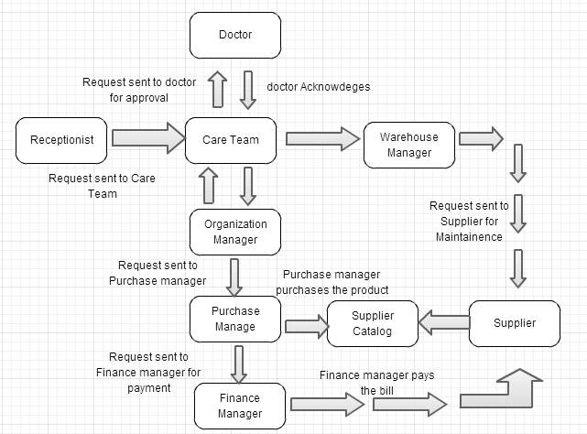
Actual Project flow

Slide 7
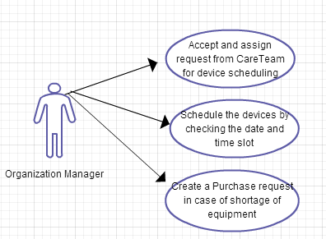
Use Cases
1. Organization Manager

Slide 8
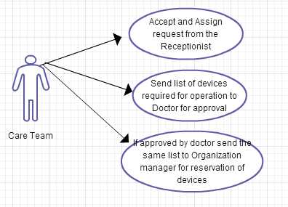
Use Cases
2. Care Team

Slide 9
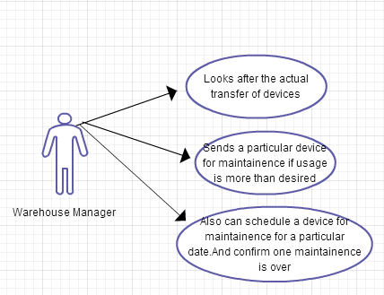
Use Cases
3. Warehouse Manager

Slide 10
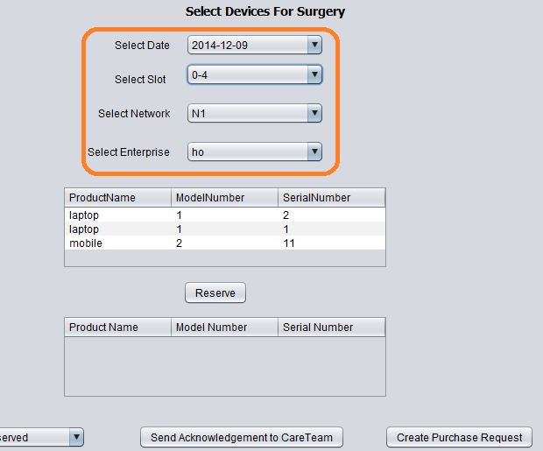
Key Features
Organization Manager is able to schedule devices on the basis of date , time and inventory choice

Slide 11
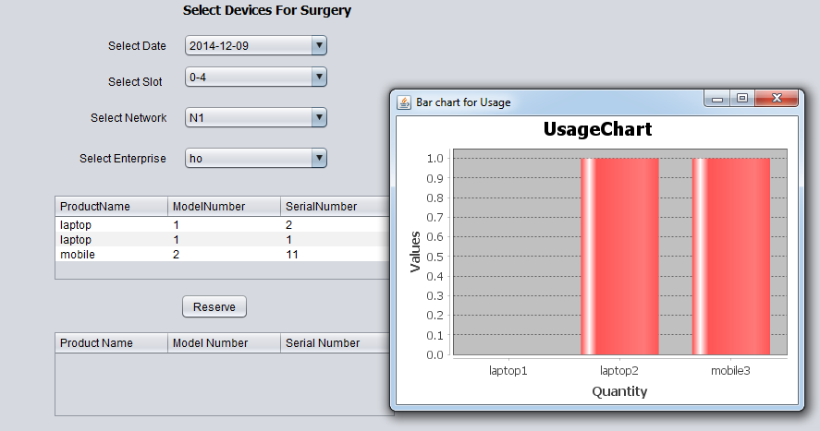
Key Features
Organization Manager is able to see usage using chart. So he can decide on future purchases for the organization

Slide 12
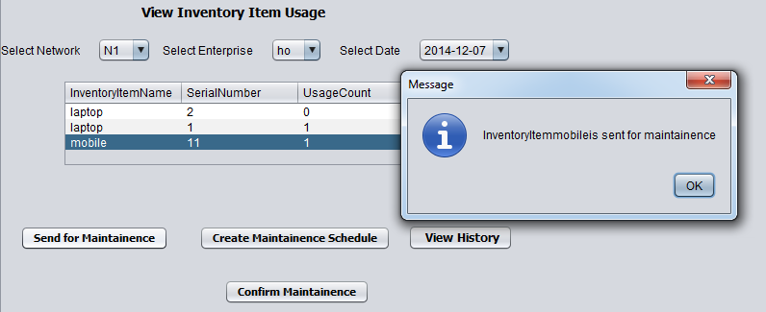
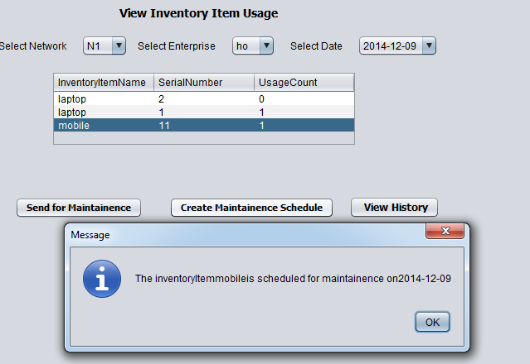
Key Features
Warehouse Manager can send a device for Maintenance on the basis of the
On Usage
On Date Schedule

Slide 13
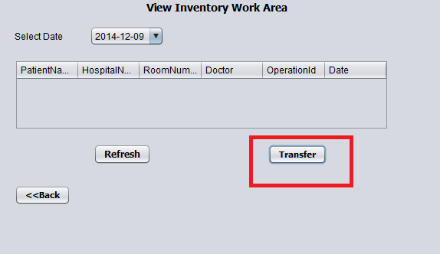
Key Features
The warehouse manager can actually transfer the devices from
1 hospital to another

